Slide 1
Lecture 2: The tidyverse
PDSS3

Slide 2
Today’s lecture
We will cover:
Tidyverse
Descriptive stats

Slide 3
Tidyverse
This chapter serves two goals. First, I will introduce you to the tidyverse, a modern way of doing R.
Second, I will introduce you to reproducible research practices. As part of this, I will talk about ways efficient workflows for analysis projects.

Slide 4
Tidyverse
The tidyverse is a modern way of doing R that is structured around a set of packages created by Hadley Wickham and colleagues. The idea is to facilitate interactive data analysis via functions that are more intuitive and ‘tidier’ than some of the corresponding base R functions.

Slide 5
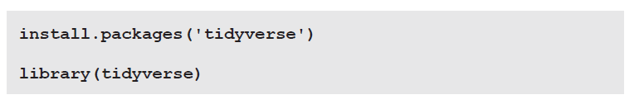
Tidyverse
Let’s begin by installing and loading in the tidyverse package (Wickham, 2017).

Slide 6
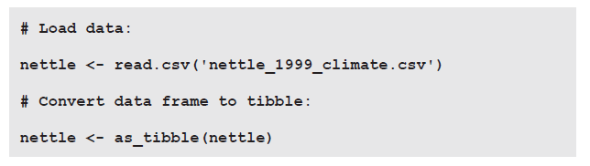
Tidyverse
tibble package
For text, tibbles default to character vectors rather than factor vectors, which is
useful because character vectors are easier to manipulate.
• Tibbles additionally display row and column numbers, saving you a lot of
nrow() and ncol() function calls.
• Finally, displaying a tibble also reveals how each column in a tibble is coded
(character vector, numeric vector, etc.).

Slide 7
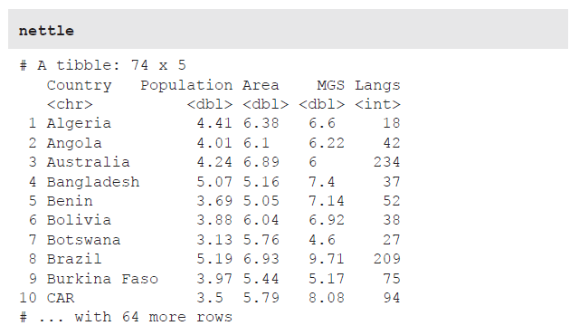
Tidyverse

Slide 8
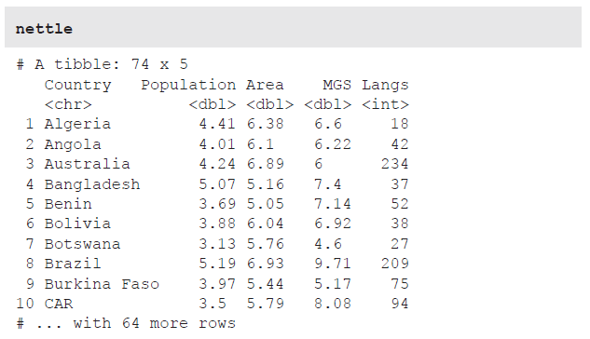
Tidyverse
readr package

Slide 9
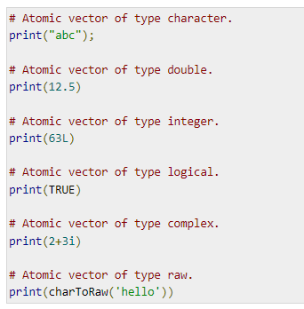
Tidyverse
Learn more about vector classes:
https://www.tutorialspoint.com/r/r_vectors.htm

Slide 10
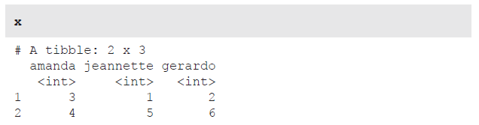
Tidyverse
read_csv() runs faster than read.csv(), and it provides a progress
bar for large datasets. For files that are not comma-separated files (.csv), use
read_delim(), for which the delim argument specifies the type of separator. The
following command loads the tab-delimited ‘example_file.txt’:

Slide 11
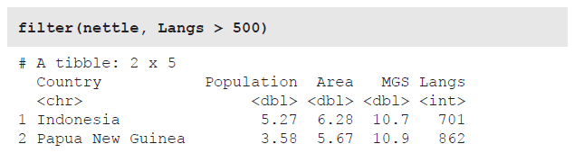
Tidyverse
dplyr package
The dplyr package (Wickham et al., 2018) is the tidyverse’s workhorse for changing tibbles. The filter() function filters rows. For example, the following command reduces the nettle tibble to only those rows with countries that have more than 500 languages.

Slide 12
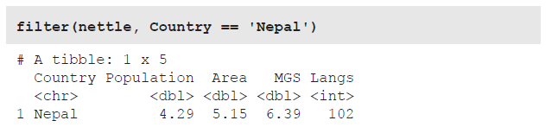
Tidyverse
dplyr package
Alternatively, you may be interested in the data for a specific country, such as Nepal:
So, the filter() function takes the input tibble as its first argument. The second argument is a logical statement that you use to put conditions on the tibble, thus restricting the data to a subset of rows.

Slide 13
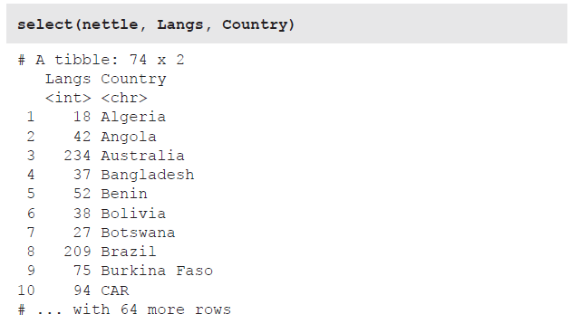
Tidyverse
dplyr package
The select() function is used to select columns. Just list all the columns you
want to select, separated by commas. Notice that the original column order does not need to be obeyed, which means that select() can also be used to reorder tibbles.

Slide 14
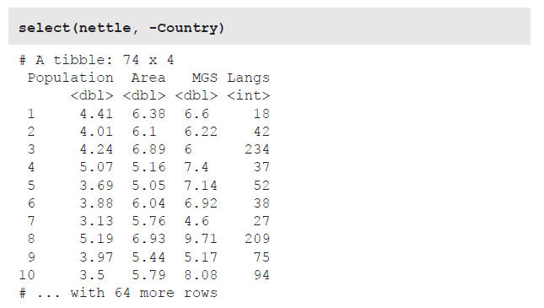
Tidyverse
dplyr package
Using the minus sign in front of a column name excludes that column.

Slide 15
Tidyverse
dplyr package
Use the colon operator to select consecutive columns, such as all the columns from Area to Langs.
To summarize the two dplyr functions introduced so far: filter() is used to
filter rows; select() is used to select columns.

Slide 16
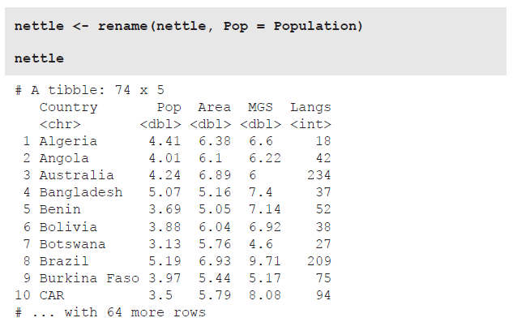
Tidyverse
dplyr package
The rename() function can be used to change the name of existing columns. Each argument is structured as follows: ‘New column name equals old column name.’ For example, the following code shortens the name of the Population column to Pop.

Slide 17
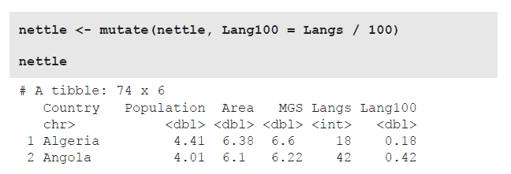
Tidyverse
dplyr package
The mutate() function can be used to change the content of a tibble. For example,
the following command creates a new column Lang100, which is specified to be
the Langs column divided by 100.

Slide 18
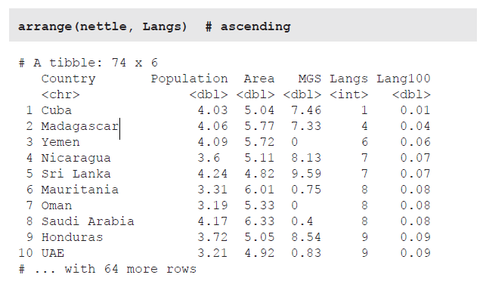
Tidyverse
dplyr package
Finally, arrange() can be used to order a tibble in ascending or descending
order. Let’s use this function to look at the countries with the largest and the smallest number of languages.

Slide 19
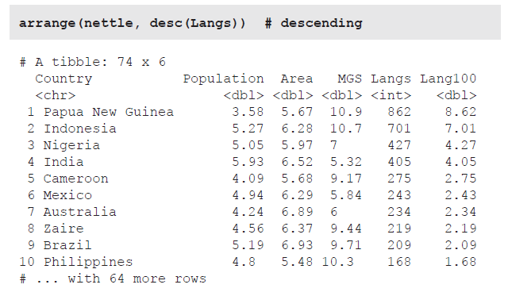
Tidyverse
dplyr package
Finally, arrange() can be used to order a tibble in ascending or descending
order. Let’s use this function to look at the countries with the largest and the smallest number of languages.

Slide 20
Tidyverse
ggplot2 package
The ggplot2 package (Wickham, 2016) is many people’s favorite package for plotting. Let’s use ggplot2 to graphically explore the relation between climate and linguistic diversity. Nettle (1999) discusses the intriguing idea that linguistic diversity is correlated with climate factors.
The proposal is that countries with lower ecological risk have more different languages than countries with higher ecological risk. A subsistence farmer in the highlands of Papua New Guinea lives in a really fertile environment where crops can be grown almost the entire year, which means that there is little reason to travel. When speakers stay local and only speak with their immediate neighbors, their languages can accumulate differences over time which would otherwise be levelled through contact.
Nettle (1999) measured ecological risk by virtue of a country’s ‘mean growing
season’ (listed in the MGS column), which specifies how many months per year one can grow crops.

Slide 21

Tidyverse
ggplot2 package
Let’s plot the number of languages (Langs) against the mean growing season
(MGS). Type in the following command and observe the result, which is shown in
Figure 2.1 (left plot)—a detailed explanation will follow.
The ggplot() function takes a tibble as its first argument. However, the rest of how this function works takes some time to wrap your head around. In particular, you have to think about your plot in a different way, as a layered object, where the data is the substrate, with different visual representations (shapes, colors, etc.) layered on top.

Slide 22
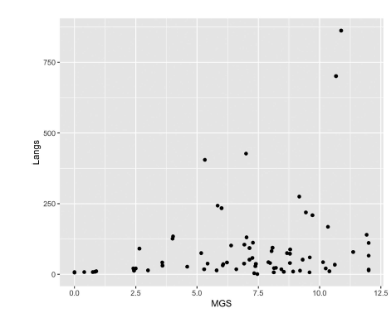
Tidyverse
ggplot2 package

Slide 23
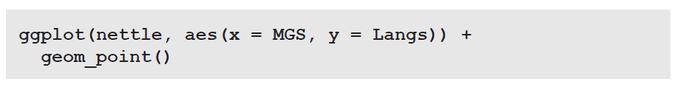
Tidyverse
ggplot2 package
The aesthetic mappings can also be defined in the ggplot2 function call (rather than in the geom). In which case all following geoms use the same mapping. Also, the aesthetics argument does not have to be named.

Slide 24
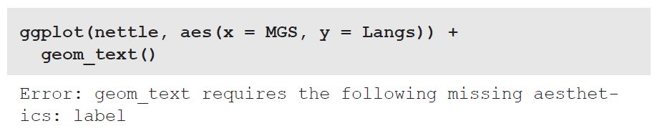
Tidyverse
ggplot2 package
Swapping geom_point() with geom_text() returns an error:

Slide 25
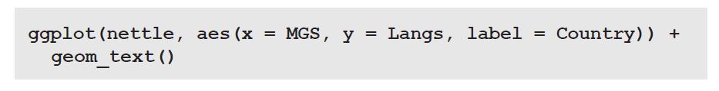
Tidyverse
ggplot2 package
The problem here is that geom_text() needs an additional aesthetic mapping. In particular, it needs to know which column is mapped to the actual text (label) shown in the plot, which is given in the Country column.

Slide 26
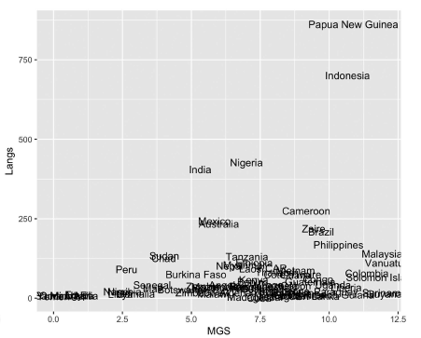
Tidyverse
ggplot2 package

Slide 27
Tidyverse
ggplot2 package
To save a plot, use ggsave() after a ggplot2 command. For example, the following command saves the text plot into the file nettle.png with the width:height ratio of 8:6 (measurement units are given in inches by default).

Slide 28
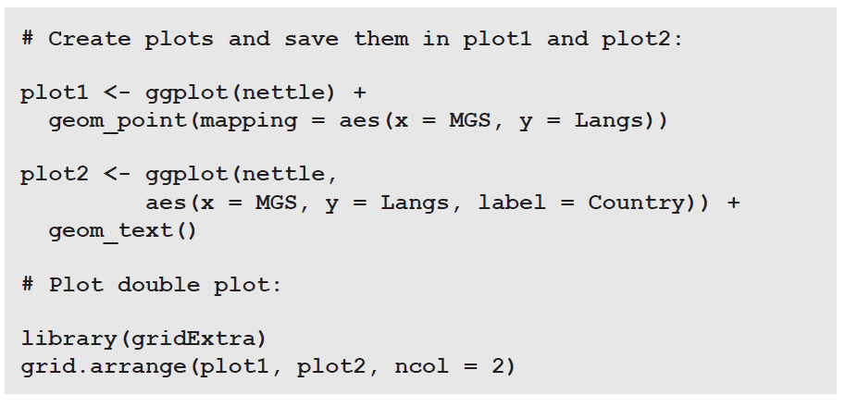
Tidyverse
ggplot2 package
To create the two-plot arrangement displayed use the gridExtra
package (Auguie, 2017).

Slide 29
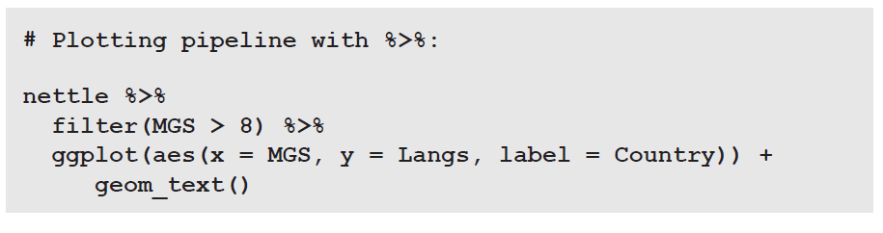
Tidyverse
Piping with magrittr
A final component of the tidyverse relevant to us is the ‘pipe’, which is represented by the symbol sequence ‘%>%’.
This functionality is unlocked by the tidyverse package magrittr (Milton Bache & Wickham, 2014).
Imagine a conveyor belt where the output of one function serves as the input to another function. The following code chunk exemplifies such a pipeline. The tibble nettle is first piped to the filter() function, which reduces the tibble to only those countries where one can grow crops for more than eight months of the year (MGS > 8).

Slide 30
Tidyverse
Piping with magrittr
A final component of the tidyverse relevant to us is the ‘pipe’, which is represented by the symbol sequence ‘%>%’.
This functionality is unlocked by the tidyverse package magrittr (Milton Bache & Wickham, 2014).
Imagine a conveyor belt where the output of one function serves as the input to another function. The following code chunk exemplifies such a pipeline. The tibble nettle is first piped to the filter() function, which reduces the tibble to only those countries where one can grow crops for more than eight months of the year (MGS > 8).

Slide 31
Lab time
Go to https://github.com/jsegoviamartin/PDSS3 week 2
Lab 2: Iconocity and senses
This lab guides you through the first steps of an analysis that was published
in Winter, Perlman, Perry, and Lupyan (2017). This study investigated iconicity,
the resemblance between a sign’s form and its meaning. For example, the words
squealing, banging, and beeping resemble the sounds they represent (also known as onomatopeia, a specific form of iconicity). It has been proposed that sound concepts are more expressible via iconic means than concepts related to the other senses, such as sight, touch, smell, or taste. This may be because auditory ideas are easier to express via imitation in an auditory medium, speech.

Slide 32
Descriptive statistics

Slide 33
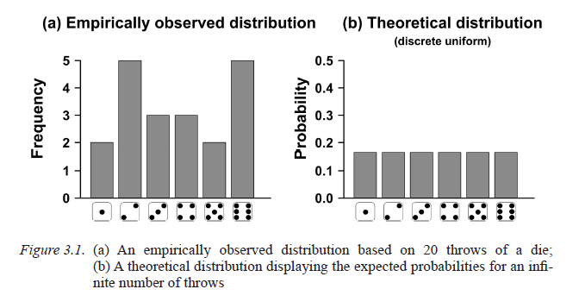
Distributions
Imagine throwing a single 6-face die 20 times in a row. For any one throw, each face is just as likely to occur as any other. We perform 20 throws and note down frequencies. The face ‘1’ comes up 2 times, ‘2’ might come up 5 times, and so on.
The theoretical probability distribution in answers the question: how probable is each outcome? We use theoretical distributions to model empirically observed data

Slide 34
The normal distribution
The normal distribution is a distribution for continuous data, centered symmetrically around the mean with most of the data lying close to the mean.

Slide 35
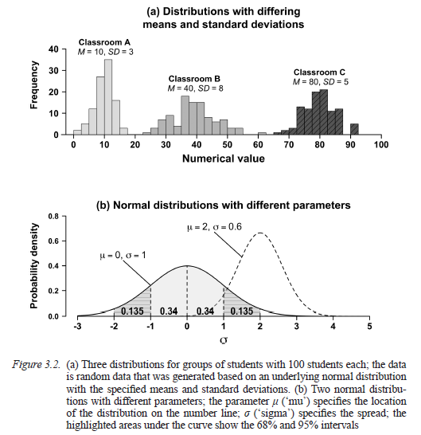
The normal distribution

Slide 36
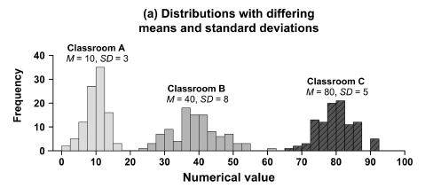
The normal distribution
The distributions in this figure also differ in terms of ‘spread’. In particular, the
distribution for classroom B is wider than the other two distributions.
The standard deviation (SD) is used to summarize this spread. Larger standard
deviations correspond to flatter histograms that fan out farther away from the mean.

Slide 37
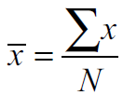


The normal distribution
sums up all the numbers
Population size (how many numbers in total)
You calculate each data point’s difference from the mean, square that value, and then
sum up the squared differences. This ‘sum of squares’ is then divided by N minus 1.
hen you take the square root of that.

Slide 38
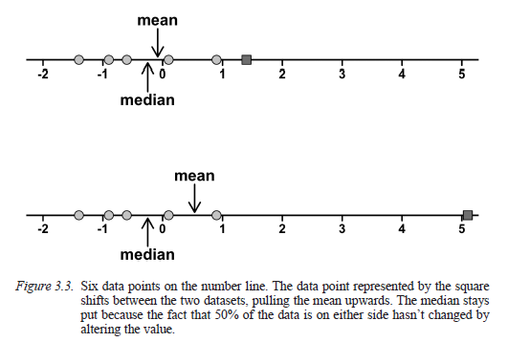
Mean, median, SD
The mean and the standard deviation are just two ways of compressing data. Another summary statistic is the median, which is the halfway point of the data (50% of the data are above the median; 50% of the data are below). In contrast, the mean is the ‘balance point’, which you can think of as a pair of scales: an extreme value shifts the mean, but not the median.

Slide 39
Mean, median, SD
The median is sometimes reported because it is more robust to variations in extreme values than the mean. For example, most people have relatively low incomes, but some people (such as Bill Gates) have incredibly high incomes. Such extremely rich people skew the mean upwards, but they don’t shift the median up as much. Mean GDP per capita might be more misleading than Median GDP per capita.

Slide 40
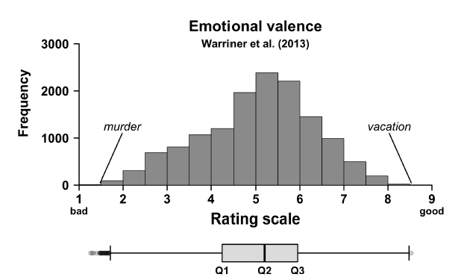
Boxplots
The distribution of emotional valence scores for the 14,000 words from the Warriner et al. (2013) rating study.

Slide 41
Boxplots
Mean = 5.06
Median = 5.2
box covers 50% of the data

Slide 42
Boxplots
Mean = 5.06
Median = 5.2
box covers 50% of the data
Q1 is the first quartile, which is the 25th percentile. The next quartile is Q2, the median. Finally, 75% of the data fall below Q3, the third quartile.

Slide 43
Lab time
Lab 2: Iconocity and senses
This lab guides you through the first steps of an analysis that was published
in Winter, Perlman, Perry, and Lupyan (2017). This study investigated iconicity,
the resemblance between a sign’s form and its meaning. For example, the words
squealing, banging, and beeping resemble the sounds they represent (also known as onomatopeia, a specific form of iconicity). It has been proposed that sound concepts are more expressible via iconic means than concepts related to the other senses, such as sight, touch, smell, or taste. This may be because auditory ideas are easier to express via imitation in an auditory medium, speech.

Slide 44
Hands-on lab
https://github.com/jsegoviamartin/PDSS3
Week 2
Lab 2
Problem_set_2
https://github.com/jsegoviamartin/PDSS3
Submit your activity-homework (Problem set 2) in github classroom

